Slide 1
Final Presentation
Best Time of Supply Development for SLCDPU, Based on Reliability Using a WEAP Model
April 28th, 2016
Hessam Tavakol, Yonas Tsegay, Seungyub Lee

Slide 2
Summary of Project
WEAP model
Assumption
Data
Scripting
Results
Conclusion
Outline
Notes:
Statement on Stakeholder
Problem that stakeholder is encountering
Objective of project
Performance Metrics
Data Collection
-Population Growth
-Conservation
-Cost related to Well
-Climate Change
WEAP model
Assumption & Data collection
Input Data in WEAP
Scenario Planning using Scripting
Result
Conclusion

Slide 3

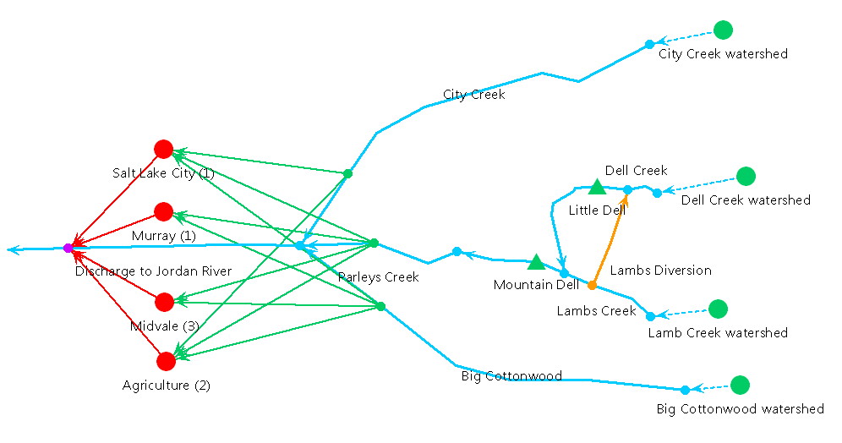
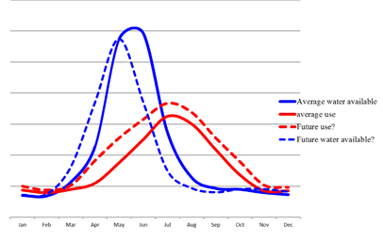
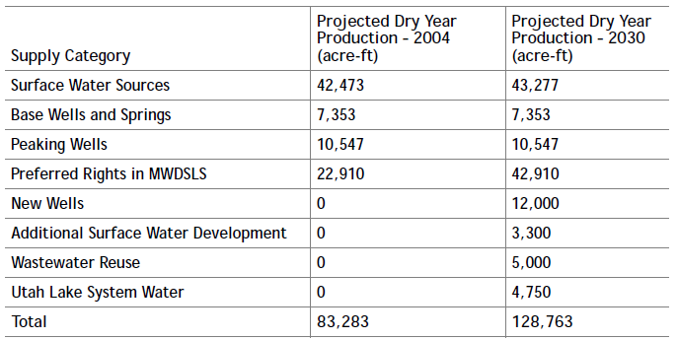

Summary of Project
Stakeholder
Salt Lake City Department of Public Utilities (SLCDPU)
Potential management problems
Earlier and decreased amount of snow melt due to climate change
Increase in demand due to population growth
Tasks Associated for Future Development
Additional Water Supply
Source Reliability
System Production Capacity
Timing of Supply Development
Conservation
Global Climate Change
Determine best timing for new well installation by reliability analysis.
Also include demand projection and climate change
*Numbers based on “2014 Salt lake City Water Conservation Master Plan”
Notes:
Again, since the proper data isn’t covered yet, the current water sources are estimated by the 2014 slat lake city water conservation master plan report

Slide 4
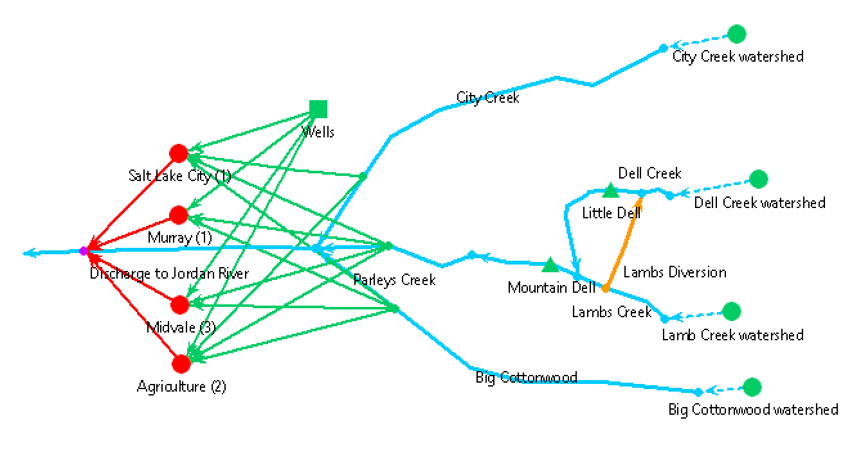
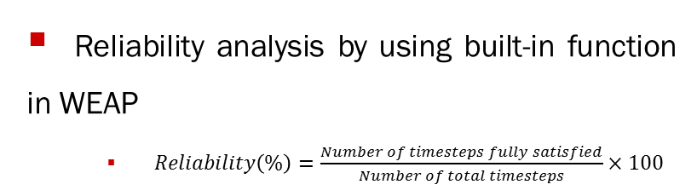
WEAP model
Climate Change
Considers climate change scenario by using projected precipitation data from CMIP3 and CMIP5 is used
Groundwater
Performance
Considers river, reservoir system, and ground water system
Reliability analysis by using built-in function in WEAP
$Reliability\left(\%\right)=\frac{Number of timesteps fully satisfied}{Number of total timesteps}×100$
Outline
Simulation through 2015 to 2049
Change installation year by scripting
Export result to text file
Demand
Demand projection by the population growth rate and conservation plan.
Notes:
Demand Projection
Climate change – Precipitation
New Well construction
Approximately take 7 minute to run

Slide 5
Assumption
Groundwater related
Groundwater well distributes water equally.
Only one well will represent whole groundwater well in service area
Storage capacity, natural recharge, and maximum withdrawal is same amount as shown in the report
Well construction will finish before 2030
Demand related
Water conservation plan and population growth apply as linear function
Climate Change related
Use historical precipitation data from 1980 to 2014 to predict precipitation data from 2015 to 2049
Performance related
We need to avoid reliability lower than 80 %
Assumed value of cost is constant
Cost function for installation is neglected
Notes:
Out project object is trying to provide the adequate model that can solve their concerns in context of their recommendation option for the water resources
System Production Capacity – It is estimated that the ultimate peak day demand in the City will be approximately 40 mgd greater than its current production capacity. If 5 mgd of additional capacity is developed through new surface water sources, it is recommended that an additional 35 mgd be developed through new ground water or other sources.

Slide 6
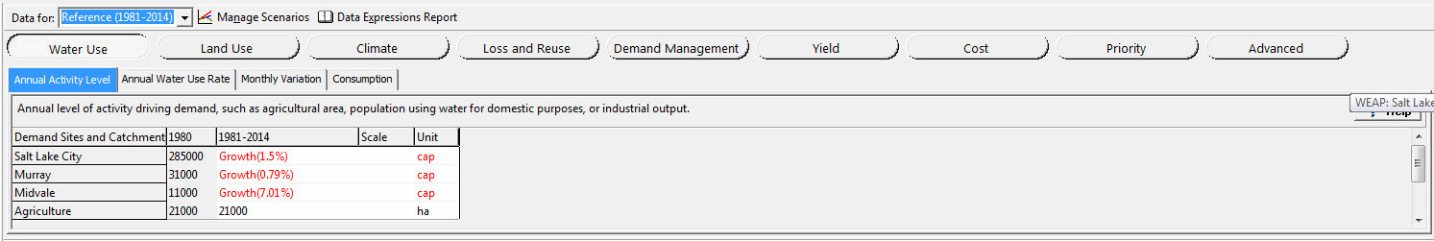
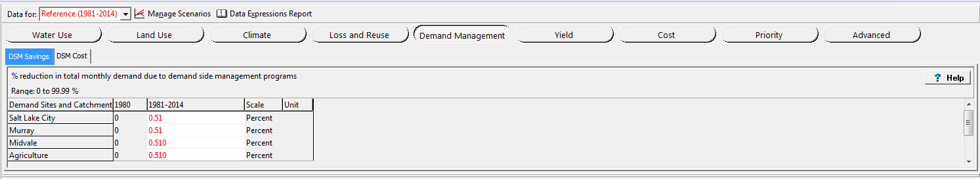
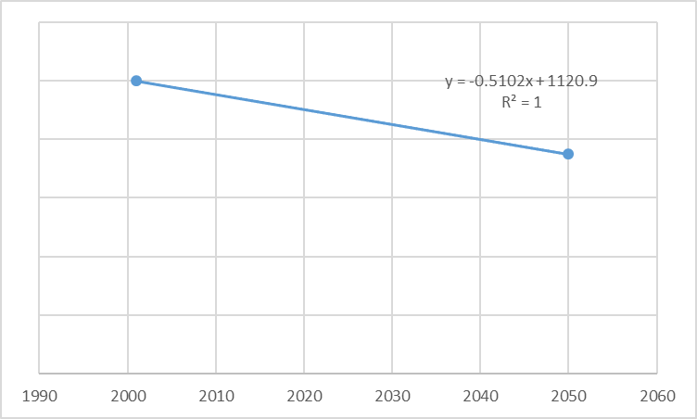
Data
Notes:
First, simulating period is same for existing and planned not only due to lack of data, but also to check the actual impact of new wells.
Second, all the springs and wells are combined in one simple source as shown in Figure 3.
Third, storage capacity if assumed to be infinite, and initial storage, maximum withdrawal, and natural recharge is assumed to be same, and 2.2 for existing and 3.7 for planned both in million cubic meter.

Slide 7
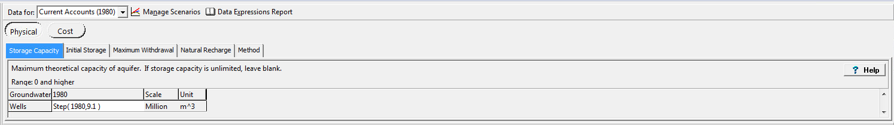
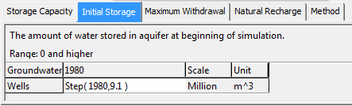
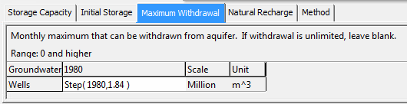
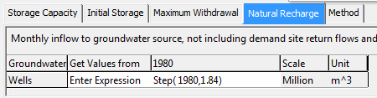
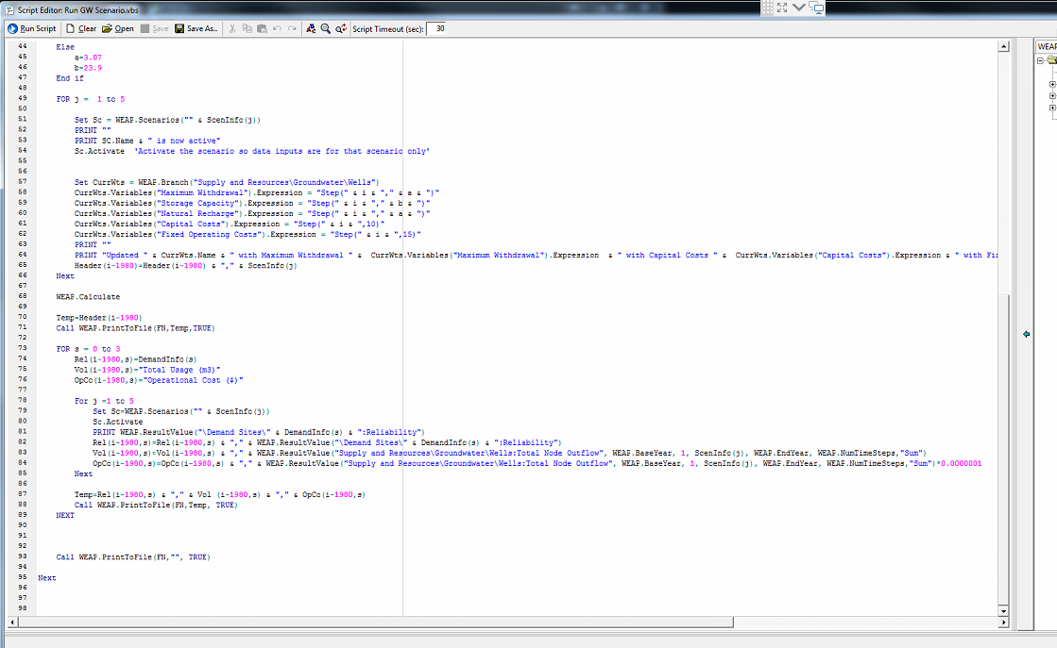
Data
Rizzo & Dougherty (1996) suggested $0.0000001/m3 for operation and maintenance cost for well.
Rizzo, D. M., & Dougherty, D. E. (1996). Design optimization for multiple management period groundwater remediation. Water Resources Research,32(8), 2549-2561.
Notes:
First, simulating period is same for existing and planned not only due to lack of data, but also to check the actual impact of new wells.
Second, all the springs and wells are combined in one simple source as shown in Figure 3.
Third, storage capacity if assumed to be infinite, and initial storage, maximum withdrawal, and natural recharge is assumed to be same, and 2.2 for existing and 3.7 for planned both in million cubic meter.

Slide 8

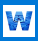

Scripting
Future Precipitation creating
Connect to the Toad and create future precipitation input data for WEAP
Running Climate Change Scenario
Write created precipitation data to WEAP
Running Groundwater Scenario
Change install year of well and print reliability, water extracted, operation cost into csv file
Notes:
First, simulating period is same for existing and planned not only due to lack of data, but also to check the actual impact of new wells.
Second, all the springs and wells are combined in one simple source as shown in Figure 3.
Third, storage capacity if assumed to be infinite, and initial storage, maximum withdrawal, and natural recharge is assumed to be same, and 2.2 for existing and 3.7 for planned both in million cubic meter.

Slide 9
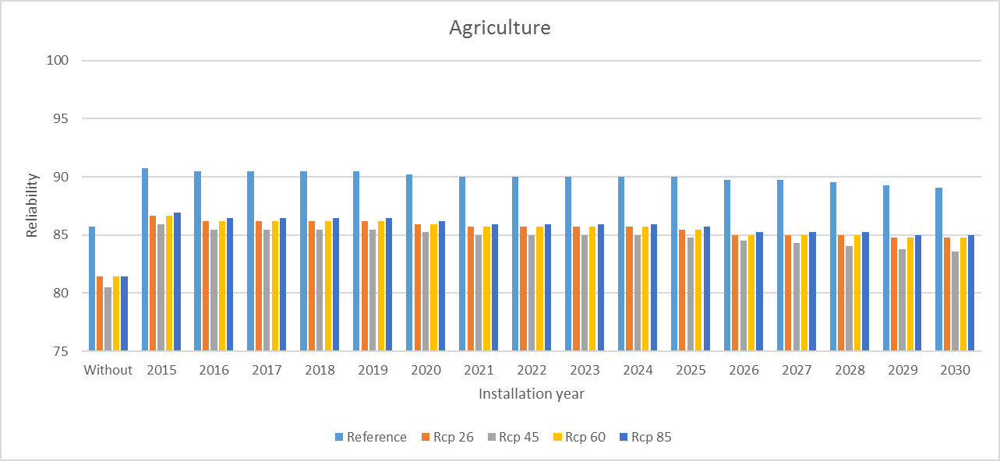
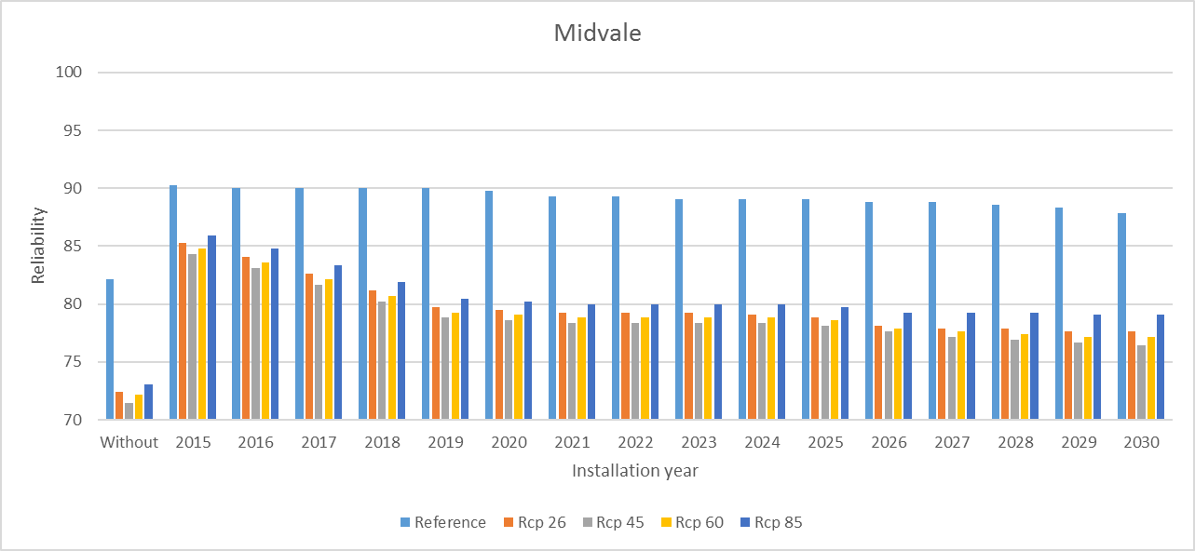

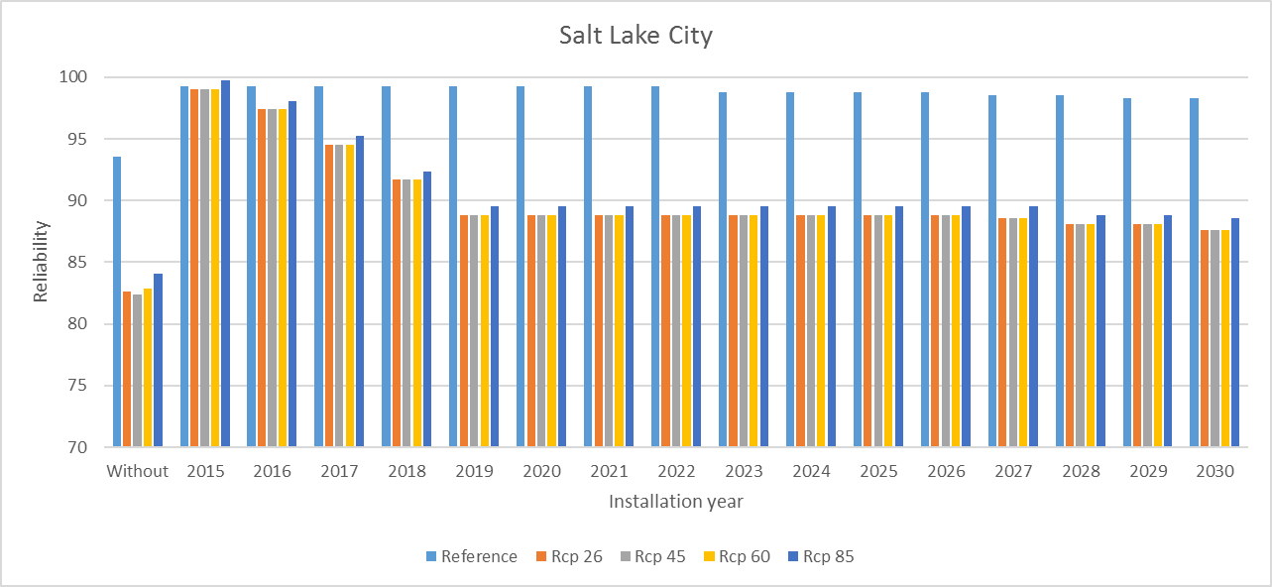

Results
Notes:
This actually shows the planned groundwater can increase the reliability compared to the existing under the demand increase scenario.

Slide 10
Conclusion
Summary of model
Current WEAP model has been modified in order to evaluate impact of groundwater wells, and reliability results shows that around 2025 is the best timing for install
Base line of demand projection considering both population growth and conservation included
If the precipitation data is present, WEAP and MySQL program can automatically create projected precipitation
Construction and operation cost is assumed for this project, but by changing single number in scripting may enable to conduct better cost analysis
Advantage of model
Using scripting, modification of each part is easy
Also scripting enable automatic calculation and print result to csv file for other visual option
Future task
Better data for better calculation is highly recommended
Visualize result and optimization by scripting
Notes:
This actually shows the planned groundwater can increase the reliability compared to the existing under the demand increase scenario.

Slide 11
Questions?
Thank you!
Any Question?
Notes:
This actually shows the planned groundwater can increase the reliability compared to the existing under the demand increase scenario.

